Slide 1
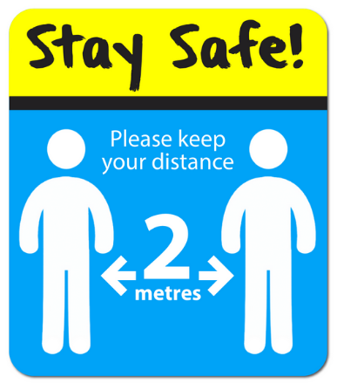
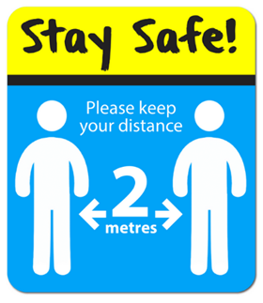
Please help us to keep the school site as safe as possible, by following these rules:
Line up using the marking tape dividers, on the pavement, of our Elvington Lane entrance (within the allotted time slot for your child’s year group drop-off).
Parents/carers will drop off their child/ren at the school gate (a member of staff will greet them).
Parents/carers will not be permitted on the school site (this is in the interest of infection control). Parents/carers should come into school building only when strictly necessary, by appointment.
At the end of the school day, please arrive at the earliest possible listed time for your child’s year group. Once again, line up on the pavement outside of school, respecting social distancing measures. Your child will then be returned to you when you reach the front of the parent/carer line.
To reduce possible contact between different groups of children, and between adults, this will be a one way system.
This guidance adheres to the measures stipulated by the Department for Education’s document - Guidance for full opening: schools.
If you have any questions, I can be contacted via email: head@elvingtonprimary.org.uk

Slide 2
Staggered drop off and collection times:
Class 1 pupils to arrive between 8.10am and 8.20am. To be collected between 2.30pm and 2.40pm.
Class 2 pupils to arrive between 8.20am and 8.30am. To be collected between 2.40pm and 2.50pm.
Class 3 pupils to arrive between 8.30am and 8.40am. To be collected between 2.50pm and 3pm.
Class 4 pupils to arrive between 8.40am and 8.50am. To be collected between 3pm and 3.10pm.
Class 5 pupils to arrive between 8.50am and 9am. To be collected between 3.10pm and 3.20pm.

