Slide 1
Exploring flowering plants

Slide 2
Parts of a flowering plant

Slide 3
_ _ l l _ _
_ _ _ _ L
_ _ t _ _
F _ _ a _ _ _ _
S_ _ _ _ _
S _ _ l _
_ v _ _ _
O _ a _ _
R _ c _ p _ _ _ _ _
S _ _ _ l

Slide 4
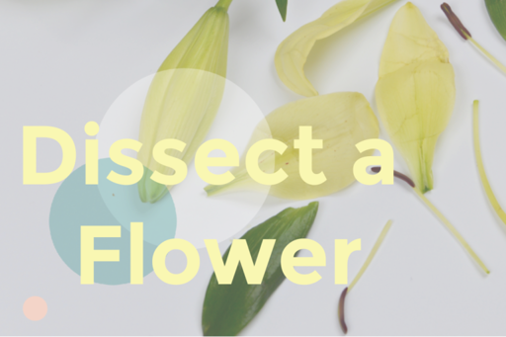
How to dissect a flower
Note: some pupils may have an allergy to flowers
  Please wear gloves, cover skin if this is the case
  Wash any utensils/ boards thoroughly after use
Any flower will do
Be creative, explore and have fun!
No flower? No problem, follow this link:
http://www.glencoe.com/sites/common_assets/science/virtual_labs/LS11/LS11.html

Slide 5
How to dissect a flower
You will need:
Any flowers with large parts work really well, for example:
  Lily, Iris, Daffodil, Tulip
Paper plates or sheets of cardboard
Tweezers
Optional: scissors (care, seek adult help)
Magnifying glass or lens/ magnifier app – all optional
  Examples of free apps: best magnifier, best magnifying glass, big magnify free. Have a practice to see which works best for you
Note: you do not need to buy a flower for this; go on a flower hunt next time you are exercising, ask a neighbour or see if there are any in your garden

Slide 6
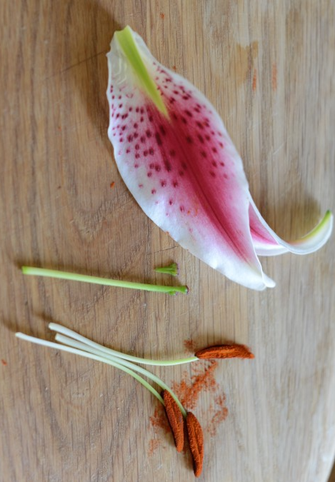
Lay your flower out over a paper plate, tray or sheet of cardboard. Gently peel back the petals
Gently pull/ pinch off any bits you find
If you like, have an adult help you by cutting any different parts of the flower out
Can you identify the different parts?
Try to find the following parts:
  Petal – attract insects, often coloured/ patterned
  Leaf – often green, uses sunlight to feed the plant
  Pollen – produced by the anthers, powdery in appearance
  Stem – supports flowers and leaves, transports water from the soil

Slide 7
Plant trial identification apps
With the help of an adult, these apps would be great to help learn more about plants and trees:
SmartPlant (Android, IOS, smartplantapp.com)
Garden Tags (Android, IOS, gardentags.com)
RHS Grow Your Own (Android, IOS, rhs.org.uk/advice/grow-your-own/app)
Garden Answers (Android, IOS, gardenanswers.com)

