Slide 1
Mathematical
Magic!

Slide 2
I am going to see if I can read your mind…

Slide 3
Think of a number between 1 and 10

Slide 4
Double it…

Slide 5
Add 8…

Slide 6
Divide by 2…

Slide 7
Subtract your original number…

Slide 8
Convert your number to the corresponding letter of the alphabet…
1=A, 2=B, 3=C, 4=D etc.

Slide 9
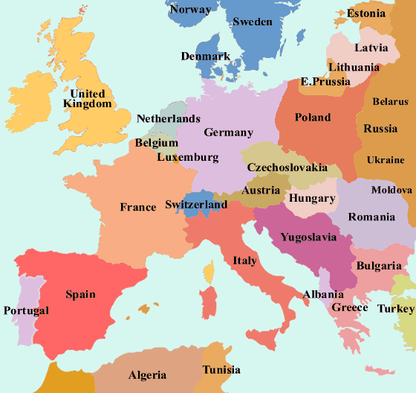
Write down a country starting with your letter…

Slide 10
Write down an animal starting with the second letter of your country…

Slide 11
Now write down the colour of your animal…

Slide 12
Now repeat after me…
MATHEMAGIC!

Slide 13
Can I read your mind?

Slide 14
Was this your animal?

Slide 15
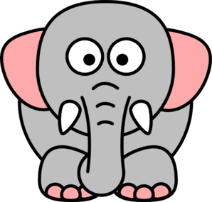
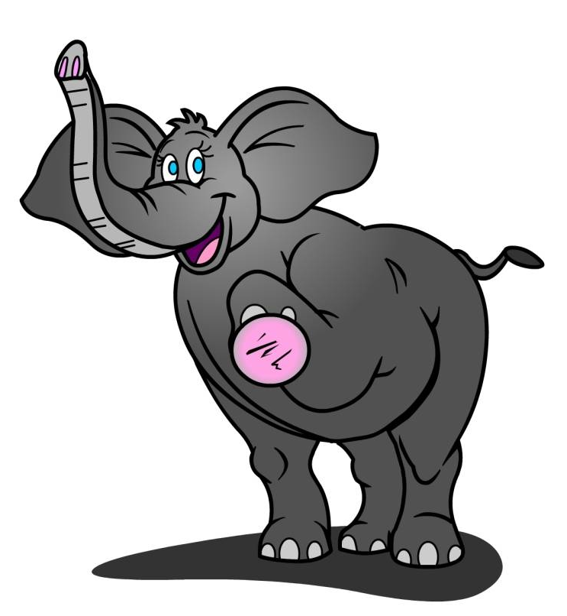
A grey elephant from Denmark?

