Slide 1
Multiplication & Division
By the end of Year 3, children should be able to recall and use multiplication and division facts for the 3, 4 and 8 multiplication tables
By the end of Year 4, children should be able to recall multiplication and division facts for multiplication tables up to 12 × 12
By the end of Year 5, children should be able to apply knowledge of multiplication and division (find factors, multiples, prime and composite numbers, square numbers)
By the end of Year 6, children have developed mathematical fluency and apply multiplication and division facts in more complex problems and calculations

Slide 2
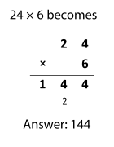
Formal Written Columnar Methods
Year 3:
Pupils should be taught to write and calculate mathematical statements for multiplication and division using the multiplication tables that they know, including for two-digit numbers times one-digit numbers, using mental and progressing to formal written methods.
24 x 6
24
6
_____
1 2 0 (20 x 6)
2 4 ( 4 x 6)
_____
1 4 4
Children must have a good understanding of the value of digits before moving onto short multiplication.
If you know 3 x 4 = 12, what else do you know?

Slide 3
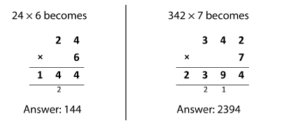
Formal Written Columnar Methods
Year 4:
Pupils should be taught multiply two-digit and three-digit numbers by a one-digit number using formal written layout.

Slide 4
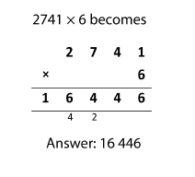
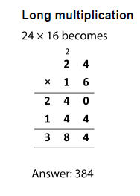
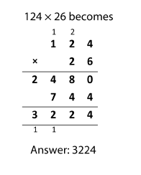
Formal Written Columnar Methods
Year 5:
Pupils should be taught to multiply numbers up to 4 digits by a one- or two-digit number using a formal written method, including long multiplication for two-digit numbers.

Slide 5
Formal Written Columnar Methods
Year 6:
Pupils should be taught to multiply multi-digit numbers up to 4 digits by a two-digit whole number using the formal written method of long multiplication.
Give it a go!
3478 x 14 =
= 48 692
Notes:
If it was 124 x 76 - jottings

Slide 6
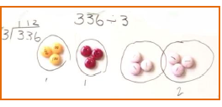
Formal division methods
Year 3:
Pupils should be taught to write and calculate mathematical statements for multiplication and division using the multiplication tables that they know, including for two-digit numbers times one-digit numbers, using mental and progressing to formal written methods.
Focus on the facts they know, including 3, 4 and 8 times tables.
Children must have a good understanding of the value of digits before moving onto more formal methods.
The inverse!

Slide 7
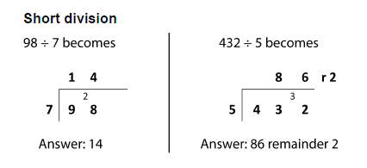
Formal division methods
Year 4:
Pupils should be taught to recall multiplication and division facts for multiplication tables up to 12 × 12
Pupils practise to become fluent in the formal written method of short multiplication and short division with exact answers.
The inverse!

Slide 8
Formal division methods
Year 5:
Pupils should be taught to divide numbers up to 4 digits by a one-digit number using the formal written method of short division and interpret remainders appropriately for the context
Remainders
Notes:
Example Q on tables

Slide 9
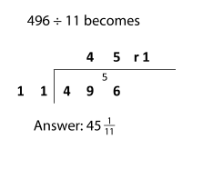
Formal division methods
Year 6:
Pupils should be taught to divide numbers up to 4 digits by a two-digit number using the formal written method of short division where appropriate, interpreting remainders according to the context
11
22
33
44
55
66
77
88
99
110
Remainders as fractions and decimals
257 ÷ 16
Notes:
Example Q
Model with smaller no.s
Decimals

