Slide 1
Maths is fun!
Maths
EYFS and KS1

Slide 2
Addition Progression in written calculation
EYFS
Counting Songs
Counting sets of objects
Counting on
Counting 1 more
Recording pictorially
Using a number line and recording numerically
KS1
Adding in any order
Blank number lines to add 2 numbers
Partitioning tens and units
Vertical Addition

Slide 3
Subtraction Progression in written calculation
EYFS
Number rhymes and sequences
Finding 1 less
Counting back
Removing objects from a group
Pictorially
Numerically
KS1
Counting back 1s, 2s, 5s, 10s
Find the difference
Blank number lines
Partitioning tens and units

Slide 4
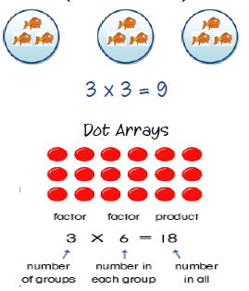
Multiplication Progression in written calculation
EYFS
Songs with counting jumps
Ants Go Marching
Sets of objects
Doubling using objects
KS1
Practical methods/Pictorial
Using number lines
Horizontal multiplication 2x3=6

Slide 5
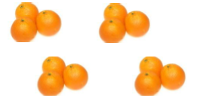
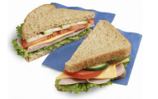
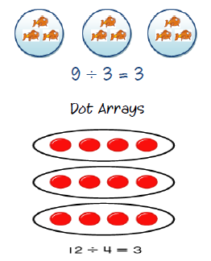
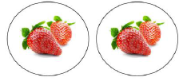
Division Progression in written calculation
EYFS
Sharing objects fairly
Cutting objects in half
Counting back in 2’s and 10’s
Halving groups of objects
KS1
Practical methods/Pictorial
Number lines (How many 5s in 25?)

